Slide 1
Portfolio Executive Committee (PEC) Review Meeting
Portfolio Overview Update, TA CRM
25-Apr-2024
40 min

Slide 2
Agenda
Topic | Presenter | Duration | Key discussion point
(I) Survodutide asset update | Yinan Zhu | 15 min
(I) EMPA +ASi asset update | Lian Zheng | 5 min
(I) Decision on EMPA-MI HA interaction | Yu Zhou | 10 min
(I) Early asset update | Hongzi Liang | 5 min
Purpose of the presentation: Information sharing (I), Advice collection (A), and Content Endorsement (E)

Slide 3
CRM Summary
OneHP priority
TA priority
new asset
Ongoing |  | Endorsed | Under Evaluation | Next Wave
Survodutide (GLP1/GCGR Agonist)/Obesity – Ph3 |  |  | Survodutide (GLP1/GCGR Agonist) /MASH Ph3, CKD Ph3, HFpEF Ph3 | BI 770371 (SIRP-alpha next gen.)/MASH gPh I ongoing in Onco China strategy TBD
Survodutide (GLP1/GCGR Agonist) – CN PK Ph1 |  |  | BI 3006337 (GLP-1/FGF21 ago.)/MASH gPh Ib MRD ongoing Target to join gPh II, FSS in Nov 2025 | BI 3060292 (NMUR2 ago.)/​Obesity gPh I FSS in Jul 2025 China strategy TBD
Survodutide (GLP1/GCGR Agonist)/MASH – Ph2 |  |  | BI 3804379 (IL-11 next gen.)/MASH gPh I FSS in Oct 2024 Target to join gPh IIa, FSS in Aug 2026 | BI3798489 (obesity) NMUR2 ago. Back-up
BI 690517 (ASi) +Empa /CKD（1378.0006）– Ph3 (fully outsourced to Oxford) |  |  | BI 3802876 (FAP-TRAILR2 ago.)/MASH gPh I ongoing Target to join gPh IIb, FSS in Jun 2027 | BI 1584862 (NASH) PAF receptor antagonist
BI 690517 (ASi)+Empa FDC/HF (1378-0014)- Ph3 |  |  | BI 765845 (MYDGF)/ Myocardial Infarction gPh IIa ongoing Target to join gPh III, FSS in H2 2027
Empa/post MI (1245-0202) – Ph3 (fully outsourced)
Avenciguat (sGC activator)/CSPH in CC (1366-0021) – Ph2
Avenciguat (sGC activator)/CSPH in CC (1366-0029) – Ph2
Avenciguat (sGC activator)/CSPH in eDC (1366-0055) – Ph2
BI 784198 (TRPC6i)/FSGS(1434-0004) - Ph2
BI 1820237 (NPY2)+GLP1/GCGR agonist FDC/obesity-Phase 2
BI 1820237 (NPY2)+GLP1/GCGR agonist FDC/obesity-Phase 1 CN PK
On track
Global strategy uncertain

Slide 4
CDE feedback on Actilyse >80y BLA application

Slide 5


Actilyse contraindication (＞80yrs) removal overall regulatory strategy
2023 |  |  |  | 2024 |  | 2025
Q1 | Q2 | Q3 | Q4 | Q1 | Q2 | Q3 | Q4
today
Global
Restrictions on >80 y was removed in label by EU since Jun 2018.
China
Original Plan
CN Variation (200WDs)
Aug. 2024 (if no formal queries)
Variation sub:
18th Aug. 2023
Variation App.
China
Verbal feedback from CDE on 19 Apr.2024 :
Acknowledge the significant unmet treatment needs in elderly (> 80ys) pts in China;
The local study (0135-0349) showed numerically higher in Actilyse group on one-year all-cause mortality (39.5% vs 38.8%) and in-hospital any intracranial haemorrhage (13.7% vs 10.8%) which is hard to provide strong justifications for safety consideration.
Suggest Sponsor to withdraw the current application AND re-submit it following the route of "Clinical Technical Requirements for Drugs Already Marketed Abroad but Not Yet in China“, with the content mainly based on global data and supplemented by Chinese data.
CN Variation (80WDs)¹
Best case²：Oct. 2024
Current Plan
Withdraw
Apr 24th
Re-sub:
Early Jun. 2024
Variation App.
No GCP inspection is expected.
Best case: If no formal deficiency letter issued, no panel meeting or CDE internal meetings required, approval is expected in Oct 2024.
5

Slide 6
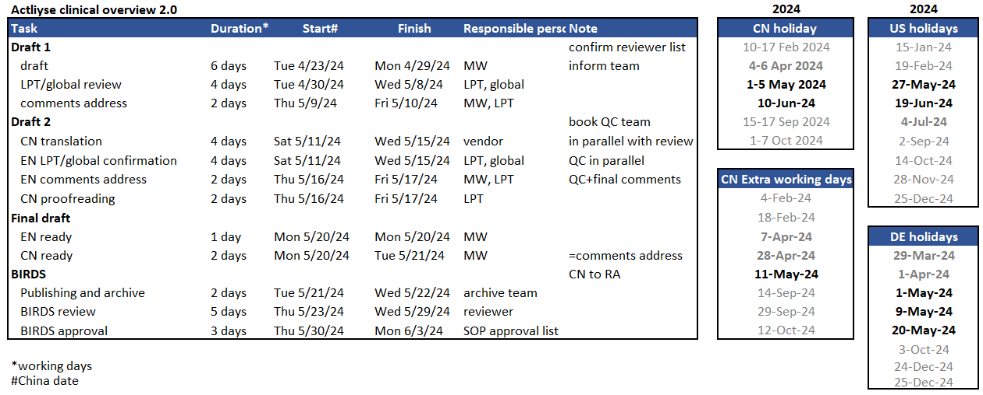
Actilyse resubmission clinical overview 2.0 timeline (BACKUP)

Slide 7
Survodutide (GLP-1/GCGR dual agonist) Projects

Slide 8


Ongoing
Survodutide (GLP1/GCGR agonist): Obesity (Ph3)
2023 |  |  |  | 2024 |  |  |  | 2025 |  |  |  | 2026 |  |  |  | 2027 |  | 2028
Q1 | Q2 | Q3 | Q4 | Q1 | Q2 | Q3 | Q4 | Q1 | Q2 | Q3 | Q4 | Q1 | Q2 | Q3 | Q4 | Q1 Q2 | Q3 Q4 | Q1 Q2 | Q3 Q4
Global
We are here
25Nov/FSS
Jul/LSR
25Feb2026/TLR
26 Jul 2026
SYNCHRONIZE-1
Obesity w/o T2DM, N=600 (up to 850)
NDA sub
26 Jul 2027
US approval
SYNCHRONIZE-2
Obesity with T2DM, N=600 (up to 850)
Global status:
Obesity Recruitment: completed for SYNCHRONIZE-1; potentially to complete the recruitment for SYNCHORNIZE-2 and CVOT earlier than planned.
30Apr
/TLR
SYNCHRONIZE-CVOT
Obesity with CV risk, N=4935 (up to 6000)
May/LSR
China
31Jan/FSS
25Feb2026/TLR
Jul/LSR
SYNCHRONIZE-1
29 Dec
2022
Mar/CDE feedback
30Nov
/CTA appr
Obesity w/o T2DM, N=60/600 (up to 850)
25Aug
6Feb/FSS
China status:
SYNCHRONIZE Recruitment updates
1) major variation for shelf-life and specification extend (to avoid OOS in stability study) is planned; 2) HAI is planned for using new stability concept for AI shelf-life claim
2025 IAP co-creation done and submitted to TALC on Apr. 22
SYNCHRONIZE-2
EoP2
CTA + EC + HGRAC + 1st SIV (5M)
Obesity with T2DM, N=60/600 (up to 850)
30AprTLR
CTA Sub
May/LSR
SYNCHRONIZE-CVOT
25Apr/
EoP2 meeting
Obesity with CV risk, N=160+55 (incl TW&HK)/4935
(up to 6000)
17Jan/FSS
Nov/LSS
31 May
15Sep
6Feb/FSS
SYNCHRONIZE-CN
Pre-IND
CTA + EC +HGRAC + 1st SIV (5M)
Obesity, BMI 24/28 N=300 (60 for MRI-PDFF)
Nov/LSC
at Week 52
(primary efficacy data for NDA submission)
CTA Sub
Jun/LSC
at Week 79
30Nov/
CTA appr
28 Dec
Jul 2024/SIV
Sep2024/LSS
May2025/LSC
Dec2025
/report archived
CN PK-1404.13
MRD study design
CTA + EC +HGRAC + 1st SIV (6M)
N = 15
CTA Sub
CN Sub. data incl.:
CN-alone
MRCT SYNCHROMIZE-1&2
CVOT
Ph1 & 2
Aug 2026
CN NDA sub
Oct 2027
CN NDA App
(best case)
Jan 2028
CN NDA App
(base case)

Slide 9
SYNCHRONIZE Program Global & China enrollment and recruitment plan (cut-off date: 22-Apr-2024)
Recruitment Completed
SYNCHRONIZETM – 1
Obesity without T2D
Global
S: 871; R:709/600
China
S: 80; R:64/60
90
80
64
60
Updates:
Recruitment Completed as planned
Pt screened (Actual)
Pt screened (Planned)
Pt enrolled/randomized (Actual)
Pt enrolled/randomized (Planned)
Notes:
MRI Sub-study: 136 R, 10 in screening

Slide 10
SYNCHRONIZE Program Global & China enrollment and recruitment plan (cut-off date: 20-Apr-2024)
SYNCHRONIZETM – 2
Obesity with T2D
Global
S: 893; R:360/600; SF: 47%
China
S: 92; R:39/60; SF: 40%
893
900
92
90
600
60
360
39
Updates:
Global may finish the recruitment earlier than expected.
Recruitment on track for China.
Pt screened (Actual)
Pt screened (Planned)
Pt enrolled/randomized (Actual)
Pt enrolled/randomized (Planned)

Slide 11
SYNCHRONIZE Program Global & China enrollment and recruitment plan (cut-off date: 22-Apr-2024)
SYNCHRONIZETM – CVOT
Obesity with CVD, CKD or
other risk factors for CVD
Global
S: 3588; R:1974/4935; SF: 25%
China
S: 93; R:47/160; SF: 12.9%
6909
200
4935
160
3588
93
1974
47
Updates:
Global recruitment may be finished earlier than expected; next wave will focus on patient with established CVD/CKD.
Local cross-functional collaboration was implemented for recruitment acceleration
Pt screened (Actual)
Pt screened (Planned)
Pt enrolled/randomized (Actual)
Pt enrolled/randomized (Planned)

Slide 12
SYNCHRONIZE Program HK & TW enrollment and recruitment plan (cut-off date: 22-Apr-2024)
SYNCHRONIZETM – CVOT
Obesity with CVD, CKD or
other risk factors for CVD
Hong Kong S: 5; R:3; SF: 0
Taiwan S: 9; R:5; SF: 1
75
27
20
56
5
9
3
5
Updates:
TW: 4 sites added sub-I from Dept. of Cardiology for boosting recruitment of established CVD/CKD patients;
HK: Sema was added into the list of SoC drugs for Pts BMI>27 with CVD in the end of 2023 (meaning chance to use Sema for free); limited candidates left; extra retention token applied; potential extra PI engagement planned.
Pt screened (Actual)
Pt screened (Planned)
Pt enrolled/randomized (Actual)
Pt enrolled/randomized (Planned)

Slide 13
SYNCHRONIZE- CN enrollment and recruitment plan (cut-off date: 22-Apr-2024)
China
S: 284; R:224/300; SF: 21%
T2D: S: 16/284; R:7/224; SF: 3
Updates:
Non-MRI sites recruitment paused when the screening number reached 250+; only 7 MRI sites allow to screen.
As the recruitment for global trials is accelerated, there is high possibility to shorten the recruitment period for SYNCHRONIZE-CN in order to catch up the timeline for simultaneous NDA submission.
Resulting a low ratio of T2DM pts in the trial, which still meets the requirement of guidance (cap for T2DM 20%)

Slide 14
Ongoing
Survodutide (GLP1/GCGR agonist): Obesity (Ph3)
2023 |  |  |  | 2024 |  |  |  | 2025 |  |  |  | 2026 |  |  |  | 2027 |  | 2028
Q1 | Q2 | Q3 | Q4 | Q1 | Q2 | Q3 | Q4 | Q1 | Q2 | Q3 | Q4 | Q1 | Q2 | Q3 | Q4 | Q1 Q2 | Q3 Q4 | Q1 Q2 | Q3 Q4
Global
We are here
25Nov/FSS
Apr/LSR
25Feb2026/TLR
26 Jul 2026
SYNCHRONIZE-1
w/o T2DM, N=709
NDA sub
26 Jul 2027
US approval
27Nov/FSS
with T2DM, N=600
SYNCHRONIZE-2
30Apr
/TLR
SYNCHRONIZE-CVOT
Obesity with CV risk, N=4935 (up to 6000)
May/LSR
China
31Jan/FSS
25Feb2026/TLR
Jul/LSR
SYNCHRONIZE-1
Obesity w/o T2DM, N=60/600 (up to 850)
6Feb/FSS
SYNCHRONIZE-2
EoP2
CTA + EC + HGRAC + 1st SIV (5M)
Obesity with T2DM, N=60/600 (up to 850)
30AprTLR
Aug 2026
CN NDA sub
Oct 2027
CN NDA App
(best case)
Jan 2028
CN NDA App
(base case)
May/LSR
SYNCHRONIZE-CVOT
Obesity with CV risk, N=160+55 (incl TW&HK)/4935
(up to 6000)
17Jan/FSS
Nov/LSS
6Feb/FSS
SYNCHRONIZE-CN
Pre-IND
CTA + EC +HGRAC + 1st SIV (5M)
Obesity, BMI 24/28 N=300 (60 for MRI-PDFF)
Nov/LSC
at Week 52
(primary efficacy data for NDA submission)
Jun/LSC
at Week 79
Sep2024/LSS
May2025/LSC
Background:
Non-MRI sites recruitment paused when the screening number reached 250+; only 7 MRI sites allow to screen.
The recruitment period for SYNCHRONIZE-2 may be shorten (potentially -5 weeks); the recruitment period for SYNCHRONIZE-CN need to be shorten in order to catch up the timeline for simultaneous NDA submission.
Resulting a relatively low ratio of T2DM pts in SYNCHRONIZE-CN, which still meets the requirement of Guidance (cap for T2DM=20%).
28 Dec
Jul 2024/SIV
Dec2025
/report archived
CN PK-1404.13
MRD study design
CTA + EC +HGRAC + 1st SIV (6M)
N = 15

Slide 15
 | Timeline* to finish the total of 300 pts R | Pros | Cons | Mitigation
MRI sites: + T2D | + 2 months (best case) | Most MRI pts – for differentiation Most T2DM pts | The efficacy data maybe lower for having highest ratio of T2DM pts Timeline delay, leaving this trial on the critical path, resulting risk for simultaneous NDA submission
MRI sites: +/- T2D | -1~0 months | Most MRI pts The efficacy data may be better for having lowest ratio of T2DM pts No risk for simultaneous NDA submission | Relatively lower ratio of T2DM pts | Following guidance criteria requirement T2DM pts data from SYNCHRONIZE -2, CVOT, CN as a whole package;
All sites: +T2D | +1 months (best case) | Median risk for timeline Most T2DM pts | Less MRI pts The efficacy data maybe lower for having highest ratio of T2DM pts Timeline delay, resulting risk for simultaneous NDA submission
*Updated timeline (LSS in 21 Oct, 2024, -5 weeks vs original plan); estimated based on decision done by end of April, 2024.

Slide 16



Site Initiation Status of SYNCHRONIZETM Studies
Key Success Factor
Frontloading Activity
  Appropriate site identification
  HOPE/Program MSA
  Local protocol amendment to meet HGR Filing strategy
Strong PI support to accelerate start-up
Cross function collaboration to ensure country readiness (e.g. CTA-A, IMP supply etc)
*estimated date of 100% SIV completion because of the complex start-up of the last site for SYNCHRONIZE CVOT
Clinical Development
and Operations
16

Slide 17
SYNCHRONIZE-1 Global enrollment and recruitment plan (cut-off date: 22-Apr-2024)

Slide 18
SYNCHRONIZE-1 China enrollment plan (cut-off date: 22-Apr-2024)

Slide 19
China sample size calculation for SYCHRONIZE-1
As global sample size 200 pts for each arm, for primary endpoint 1) ‘Change in body weight(%) from baseline to week 80’, re-calculated power will be greater than 99.99%. for primary endpoint 2) ‘Body weight reduction ≥5% from baseline at week 80’, re-calculated power will be 99.98%.
Table1. Probability for two primary endpoints showing consistency with global results based on different fractions
China fraction/ Total pts number | Two primary endpoints | 5%/ n*=30 | 6%/ n*=36 | 7.5%/ n*=45 | 10%/ n*=60 | 15%/ n*=90
Method 1 Pr (ΔChina / ΔAll >0.5 | Significance in entire population) | Endpoint 1)& | 88.2 | 90.3 | 92.9 | 95.9 | 98.3
 | Endpoint 2)# | 76.6 | 79.6 | 80.9 | 84.9 | 90.4
Method 2 Pr (ΔChina > 0 & Δex-China > 0 | Significance in entire population) | Endpoint 1) | 99.0 | 99.3 | 99.8 | 99.9 | 99.999
 | Endpoint 2) | 88.2 | 90.9 | 93.6 | 96.4 | 98.8
& 2-sided significance level of 0.025 for each dose;
# 2-sided significance level of 0.025 for each dose;

Slide 20
SYNCHRONIZE-2 Global enrollment and recruitment plan (cut-off date: 20-Apr-2024)
Global Status: 893 screened, 360 randomized, 316 screened failure (SF 47%)

Slide 21
SYNCHRONIZE-2 China enrollment plan (cut-off date: 20-Apr-2024)
China Status: 92 screened, 39 randomized, 26 SF,

Slide 22
SYNCHRONIZE-CVOT Global enrollment and recruitment plan (cut-off date: 22-Apr-2024 )

Slide 23
SYNCHRONIZE-CVOT China enrollment plan (cut-off date: 22 Apr 2024)
•Number of Subjects screened without established CVD/CKD： 19 （screen failed ：3）
•Number of Subjects screened with established CVD/CKD：19

Slide 24
SYNCHRONIZE-CVOT Hong Kong enrollment plan (cut-off date: 22 Apr 2024)
HK Status: 5 screened, 3 randomized ​

Slide 25
SYNCHRONIZE-CVOT Taiwan enrollment plan (cut-off date: 22-Apr-2024)
Taiwan status: 9 screened; 5 randomized; 1 screen failure

Slide 26



Intensive Competing Environment for CWM in China Market
2023 | 2024 | 2025 | 2026 | 2027 | 2028 | 2029 | 2030 | Later
Beinaglutide
(Benemae Pharma)
Tirzepatide
(Eli Lilly)
GLP-1/GIPa
Mazdutide (6mg)
(Eli Lilly/Innovent Bio)
GLP-1/GCGa
Mazdutide*(9mg)
(Eli Lilly/Innovent Bio)
GLP-1/GCGa
Ecnoglutide
(Sciwind)
Noiiglutide
(Hengrui)
HRS-9531
(Hengrui)
GLP-1/GIPa
HS-20094
(Hansho)
GLP-1/GIPa
BI 1820237
(BI)
GLP-1/GCG + NPY2a
Q3
2031
Q1
Q3
H1
H1
Q1
Q1
Q2
Liraglutide Gx
(Huadong)
Semaglutide
(SC)
(Novo Nordisk)
Semaglutide
(oral)
(Novo Nordisk)
CagriSema
(Novo Nordisk)
GLP-1+LA Amylin
Retatrutide
(Eli Lilly)
GLP-1/GIP/GCGa
GX-G6
(Taslypharma)
GMA105
(Gmax/Gan & LEE)
HEC88473
(HEC)
GLP-1/FGF21
Q3
Q1
2032Q1
Q3
Q4
Q2
Q2
Orlistat
(Roche)
Lipase inhibitor
Survodutide
(BI)
GLP-1/GCGa
2031 Q1
Orforglipron*
(Eli Lilly)
HRS-7535
(Hengrui)
BGM0504
(Bright Gene)
GLP-1/GIPa
Q1
Innovent submitted NDA for Mazdutide 6mg on 2Feb, launch device is AI.
Q1
Q3
GZR 18
(Gan & Lee)
2031Q3
VCT 220
(Incentage)
2031
Q1
Approved Assets
MDR-001
(Mind Rank)
*According to press release, 9mg Ph3 will initiate in 2023
#Pegapamodutide (LY2944876) PhII in T2D finished. No more updates
2031Q3
Note:
For assets with no China specific trial, approval timeline is assumed to be 2 years after US approval; for assets with China specific trial, refer to appendix for assumption methodology; Approval timeline is based considering single pivotal trial in China
Key competitors identified from assets in ≥ Phase II development
Oral
Injectable
Mono agonists
Dual agonists
Triple agonists
Notes:
Oral GLP1 trials:
Orforglipron: Ph2 36w, Ph3 72w, CVOT (Ph2 starts in 2021.09, Ph3 starts in 2023.06, Ph3 completes in 2027.9)
Semaglutide: Ph2 52w, Ph3 64w
Danuglipron: Ph2b 26w, Ph3 停止研发
Madzutide: Ph2 24w, Ph3 52w (Ph2 starts in 2021.6, Ph3 completes in 2024.1)
Assumption:
GSBR-1290 Ph2 completes in 2024H2, Ph3 starts in 2025 Q4, benchmark Orforglipron
ECC5004 Ph2 starts in 2024Q4, benchmark Orforglipron
HRS-7535 Ph2 starts in 2024Q4, benchmark Mazdutide

Slide 27
Ongoing:
Survodutide (GLP1/GCGR agonist): Metabolic dysfunction-associated steatohepatitis (MASH)
2022 |  |  |  | 2023 |  | 2024 |  |  |  | 2025 |  |  |  | 2026 |  |  |  | 2027 |  | 2025 |  | 2028 |  |  |  | 2029
Q1 | Q2 | Q3 | Q4 | H1 | H2 | Q1 | Q2 | Q3 | Q4 | Q1 | Q2 | Q3 | Q4 | Q1 | Q2 | Q3 | Q4 | Q1 | Q2 | Q3 | Q4 | Q1 | Q2 | Q3 | Q4 | H1 | H2
Global
We are here
15 Sep 2022
8 Dec
2023
2Feb
2024
Global status:
Phase 3 Pre-IND submission was submitted, feedback expected in May
Ph2-1404.43
N=295
Feb2024
/key results
12Jan2032
LSS
LSC
DBL
19 Oct 2024
May 2027
Ph3-1404.44
FOS trial
MASH F2/3
Mar2024
EoP2 sub
FSS
Interim analysis
Accelerated sub/appr (F2/3): Oct 2027/Mar2028
Key
results
Ph3-1404.64
FOS trial
19 Oct 2024
MASH F4
Apr2029
FSS
Key
results
Full sub/appr (F2-4): Sep 2029/Feb 2030
China
15 Sep 2022
8 Dec 2023
31Jan
2024
Ph2-1404.43
N=20/14 (China mainland)
N=5/4(HK) N=3/6(TW)
Ph3-1404.44
FOS trial
LSS
LSC
DBL
Feb2024/key results
Mar2024
EoP2 sub
Recruitment Window: TBD
Ph3-1404.64
FOS trial
27
Accelerated NDA submission: Nov 2027
Approval: Aug 2028 (best), Jan 2029 (base)
Full sub/appr (F2-4): Oct 2029/Dec 2030
Recruitment Window: TBD
China status:
EoP2 HAI submission submitted on 22 Mar,2024, feedback expected in Jun.
BTD application planned in Apr/May 2024 using general indication of “MASH”
Local communication channel with CRO (PXL) established
Leading PI Proposal for PEC Endorsement
  Prof. Wei, Lai (BJ Tsinghua ChangGeng Hospital) for 1404.44
  Prof. You, Hong (BJ Friendship Hospital) for 1404.64
Notes:
CTA+EC+HGRAC+1st SIV=4.5m

Slide 28

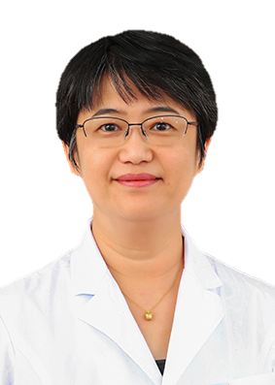
MASH Phase 3 Program China Leading PI Selection
1404.0044, MASH (F2/3) Leading PI:
Director of the Hepatobiliary and Pancreatic Center At BJ Tsinghua Changgung Hospital;
President elect of Asia-Pacific Association for Study of Liver Disease (APASL);
President of the Chinese Society for Hepatology, Chinese Medical Association;
Member of AASLD and EASL;
Leading PI of Survodutide MASH Phase 2 (5S/2R);
PI of Semgalutide MASH Phase 3
Site start up timeline acceptable (Pro: EC review in parallel with HA review , MSA established; Con: late feedback from GCP office)
Prof. WEI, Lai
Dep. Hepatology
BJ Tsinghua Changgung Hosp.
1404.0064, MASH (cF4) Leading PI:
Vice President of Beijing Friendship Hospital Affiliated to Capital Medical University;
Executive Committee member of APASL;
Member of Chinese Society of Gastroenterology, Chinese Medical Association;
Co-authored guideline for the Asia-Pacific region and domestic consensus guideline for liver disease
PI of Survodutide MASH Phase 2 (17S/5R); Leading PI of CSPH projects of SGc agonist (1366-0021)
Site participates in Semgalutide MASH Phase 3
Site start up timeline superior (Pro: fast SIV and sample export; Con: contract of exploratory endpoint issue)
Prof. YOU, Hong
Liver Research Center
BJ Friendship Hosp.

Slide 29
Key item about leading PI discussion*
Potential investigator name** | Hospital/ department** | Academic experience, especially in clinical studies(weight 15%**) | Impact in Therapeutic Area (weight 20%**) | Leading PI feasibility(weight 30%**) | Leading site start up timeline feasibility(weight 35%**) | Finial proposal for leading PI selection (Y/N)
Lai Wei(魏来） | 北京清华长庚医院 | 14% | 20% | 行政职务清华长庚医院院长 leading PI of 1404-0043， 筛选5例，入组2例 PI积极性比较高，拜访很配合 正在参研司美格鲁肽 3期MASH试验 25% | 立项1周，后可以平行合同伦理遗传办 伦理可以前置，伦理上会1月两次（已官网为准），上会需要医学项目经理都要到场 合同审核2-3个月（框架协议为基础对探索性部分提出的comments较少，但机构回复的很慢-1404-0038） 样本出境（1404-0043） HGRAC大约需要2-3周。立项到启动大概4-5个月 劣势：虽然有MSA， 既往经验，机构回复比较慢，会是合同审阅的限速条件 30% | 89%
Hong You(尤红） | 首都医科大学附属北京友谊医院 | 15% | 18% | 行政职务友谊医院副院长 leading PI of 1366-0021 1404-0043作为参研单位筛选全国第一，筛选17例，入组5例 该中心是司美格鲁肽牵头单位，但尤红不是leading PI（贾继东） PI积极性很高，对BI项目比较支持，拜访很配合 26% | 立项伦理可以同时进行，立项1周可以通过，后可以排伦理会， 伦理会每月1次， 会后2周出意见， 预计2周批件 合同审核2-3个月，如涉及探索性样本有可能不通过 HGRAC需要伦理批件， 所有合作单位签章页，按既往经验可以先递交后补 样本出境（1366-0021），较其他中心快些 立项到启动大概4-5个月 劣势： 探索性样本协议目前依然不确定 27% | 87%
* The discussion should be done before formal contact investigators/experts at early stage
** The final score would be a reference and base for team’s discussion. CD&O makes final decision of leading PI. The dispute from CDMA can be escalated to PEC for final decision.

Slide 30
Key item about leading PI discussion*
Potential investigator name** | Hospital/ department** | Academic experience, especially in clinical studies(weight 15%**) | Impact in Therapeutic Area (weight 20%**) | Leading PI feasibility(weight 30%**) | Leading site start up timeline feasibility(weight 35%**) | Finial proposal for leading PI selection (Y/N)
Jinlin Hou(侯金林） | 南方医科大学南方医院 | 13% | 17% | 行政职务南方医院肝病中心主任 Leading PI of 1366-0055, 在1404-0043中筛选8例，入组1例 PI积极性比较高 正在参研司美格鲁肽 3期MASH试验 23% | 立项有立项评估会，时间不定，机构老师不容易联系到， 快的话立项2周就可以完成，慢的话大概需要3个月， 作为组长单位可以加速； 立项完之后可以审合同，合同审阅2个月； 伦理会每月2-3次， 不需要组长单位批件，从上会拿到批件大概需要1-1.5个月 HGRAC 大约需要1-2周，总体评估立项顺利的话到启动大概需要4个月 劣势： 立项评估会目前不能确定是否要提前预约（61的经验是没有约上立项评估会，3个月后机构老师回复直接线上审核），立项有不确定性， 但作为组长单位可以加速 28% | 81%
Junping Shi (施军平) | 杭州师范大学附属医院 | 15% | 20% | 行政职务杭二感染科主任常务副院长 Leading PI of 1366-0029 PI比较积极，寻求更多的leading或其他合作机会（feedback from 29) 未参与NASH 2期试验 24% | 可以伦理前置，立项可以接收受理通知书，大约1周立项完成 立项通过后，按照官网要求准备资料，伦理会前，提前25个工作日上传CTMS线上审核，提前7个工作日提交纸质版， 上会后预计2周出意见或批件 作为组长单位可以加速 3. HGRAC大约需要2周， 总体评估结合29经验从立项到启动预计4-5个月 劣势： CIQ样本出口在29有个风险评估，有些耽误，不确定对后续的样本出口是否有影像，需进一步确认 28% | 87%
* The discussion should be done before formal contact investigators/experts at early stage
** The final score would be a reference and base for team’s discussion. CD&O makes final decision of leading PI. The dispute from CDMA can be escalated to PEC for final decision.

Slide 31
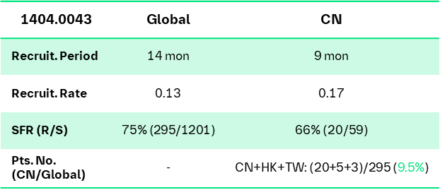
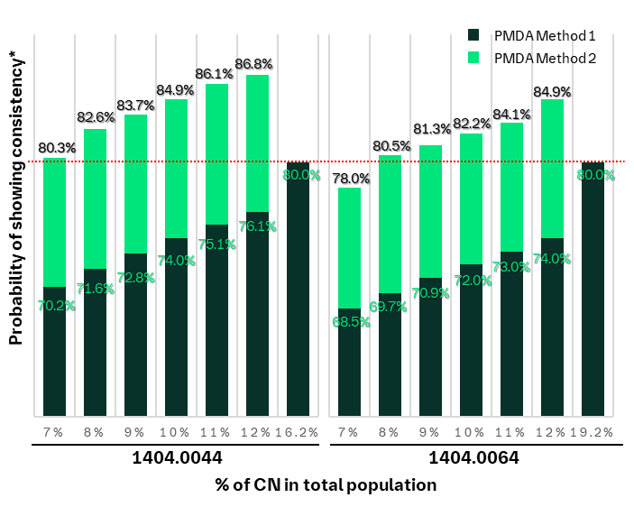
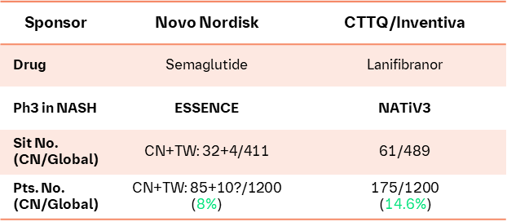
CN sample size (incl HK and TW): 8% for Study 44 (MASH F2/3) and 7% for Study 64 (MASH F4)
Global preliminary feasibility check
  Study 1404.0044 (F2/3):
  CN 82+HK 22+TW 22 = 126 (7%)
  Study 1404.0064 (F4):
  CN 56+HK 19+TW 21= 96 (6.2%)
 | 2. CN track record in MASH Phase 2: 9.5%
3. Industry benchmark: 8% - 14.6% | 4. Statistical consideration

Slide 32
NASH faces huge unmet needs that will not be fulfilled soon
Tirzepatide
GLP-1/GIPa
(Eli Lilly)
2026 | 2027 | 2028 | 2029 | 2030 | 2031-2033 | 2034-2036
Pegozafermin
(Bio89)
FGF21a
Semaglutide
(Novo Nordisk)
GLP-1
Lanifibranor
(Inventica)
PPARa
Semaglutide
(Novo Nordisk)
GLP1
Mazdutide
(Innovent Bio)
GLP-1/GCGa
HSK31679
(Haisco)
THR-β
Efinopegdutide
(Merck/Hanmi)
GLP-1/GCGR
ZSP1601
(Raynovent)
PDE
Q1
Q3
Q1
Q1
Efruxifermin
(Akero)
FGF21a
Survodutide
(BI)
GLP-1/GCGa
Survodutide
(BI)
GLP-1/GCGa
TQA2225
(Anyuan)
FGF21a
VSA006
(Visirna)
HSD17B13
AZD2693
(Astra Zeneca)
PNPLA3
ASC41
(Ascletis)
THR-β
Q2
Q3
BGT-002
(Burgeon)
ACLY
Denifanstat
(Ascletis)
FAS
GLP1/GCGR | 3
FGFR | 3
PPAR | 2
FXR | 1
GLP1 | 1
GPP1/GIP | 1
THR-β | 1
Other | 4
PF-06865571
(Pfizer)
DGAT2
Oral
Injectable
Carfloglitazar
(Chipscreen)
PPARa
Full approval
Conditional approval
HEC96719
(HEC)
FXR
Note:
Only for assets with clinical trials after Phase I conducted in China mainland; approval timeline is estimated based on BI’s Ph3 design outline.
For assets after 2032, assuming the possibility of conditional approval is low, because there will be available treatments.
GH509
(1Globe)
Unknown
Notes:
For assets during 2031-2033, they are at Ph2 development stage, and Ph2 trial will end in 2024-2025. Survodutide Ph2 will have primary read out in Feb 2024, earlier than these assets. Considering the exact timing of Ph3 is difficult to estimate, we use Ph3 TDO (trial document outline) for reference.

Slide 33


Planning:
Survodutide (GLP1/GCGR agonist): CKD & HFpEF
2023
2024
2025
2026
2027
2028
2029
2030
Building out CRM positioning
Mar 2025
Ph II/III: CKD in PwO (n=4000)
Ph III: HFpEF in PwO (n=6000)
Jul 2024
HAI Sub.
  Survodutide is indicated
  To reduce the risk of kidney disease progression*, CV death or HHF
  To reduce the risk of CV death or worsening of HF
  Patients with CKD patients at risk of progression with overweight or obesity (BMI >25 kg/m²) and
  eGFR 20–90 ml/min/1.73m²​
  UACR >200–5000 mg/g​
  Patients with HFpEF and obesity (BMI ≥30 kg/m²) and
  LVEF>40%, NYHA class II-IV
  eGFR>20 mL/min/1.73 m² (CKD-EPI)
  NTproBNP cut-offs based on BMI
Notes:
CTA+EC+HGRAC+1st SIV=4.5m

Slide 34
ASi+EMPA Projects

Slide 35
Ongoing:
BI 690517 (AS inhibitor): Chronic Kidney Disease (CKD)
2022 |  |  |  | 2023 |  |  |  | 2024 |  |  |  | 2025 |  |  |  | 2026 |  | 2027 |  | 2028
Q1 | Q2 | Q3 | Q4 | Q1 | Q2 | Q3 | Q4 | Q1 | Q2 | Q3 | Q4 | Q1 | Q2 | Q3 | Q4 | Q1 Q2 | Q3 Q4 | Q1 Q2 | Q3 Q4 | Q1 Q2 | Q3 Q4
Global
FDA fast track designation in Oct
TLR/ 8 Aug
2 Feb 2022
9 Dec 2022
10 Jul
NDA App
Aug 2028 (best case*)
Sep 2029 (base case**)
Ph2-1378.5
N=552
25Mar2024
FSS
LSS
LSC
Ph3 final protocol
Global status:
Oct HPSC endorsed RoFD for CKD
Ph3 study will follow similar collaboration model with Oxford as that of EMPA-KIDNEY
Jul2024
Aug2026
Jun 2028
Ph3-1378.6
FOS to Oxford
N=11,000 (DKD & non-DKD)
1st SIV/FSS
LSS
LSC
China
China status:
HA interaction:
1) Meeting minutes and supplemental responses sent back on 11th APR, after online meeting with CDE.
2) CTA submitted on 26th APR
NDA appr:
Jan 2029 (best case*)
Oct 2030 (base case**)
24 Mar
9 Jun
7 Dec 2022
30 Jun 2023
Ph2-1378.5
N=16/7 (China ML)
N=1/5(HK)
1st SIV
FSS
LSS
LSC
Nov
2023
Feb
2024
late Apr
2024
Oct
2024
Jun 2028
Ph3-1378.6
FOS to Oxford
Pre-IND
CTA+ EC + HGRAC + 1st SIV
Recruitment Window: TBD
N = 1,100+400/11,000 (DKD: 480+200/680;
nDKD: 620+200/820)
Pre-IND
sub
Pre-IND feedback
CTA Sub
CTA App
LSS
LSC
Detailed timelines to be confirmed by Oxford
*Best case: NDA approval based on NDA submission with interim analysis.
** Base case: NDA approval based on NDA submission with final analysis
Notes:
If CDE had concern on Oxford Livia system and streamline study design, Oxford agrees to make local protocol amendment and adopt an independent way of data collection in China to meet HA’s requirement
In the progress of aligning with AT on the potential risk of current RCC selection and next steps
Communication: internal regular catch-up btw global and local Clinops; 3-party meeting as per need

Slide 36
RCC issue
Fuwai are operational leadership
No Co-RCC structure in China
Have a Fuwai-based senior nephrologist join the CCO
Develop an Oxford-run EASi-KIDNEY “Senior Investigator Advisory Group” in China, to include proposed investigators
Oxford feedback
Prof.Liu reject this trial, and Fuwai would be the only RCC
Prof. Li Jing from Fuwai Hospital would be the RCC in China
1
2
3
4
Prof. Li is a cardiologist rather than nephrologist
Fuwai’s previous performance on EMPA-KIDNEY was poor (less than 3%(27/986) of Chinese population)
As limit impact of current RCC on Nephrology,
It was observed in EMPA-KIDNEY that Fuwai cost much longer site set-up time and was presented limited resource to ensure enough oversight on study quality.
Suggested to replace/Co-RCC with Prof.Liu Zhihong, similar as Empa-kidney
Consider to replace / Co-RCC with below local top nephrologist
Guangdong General hospital, Prof YU Xueqing
Shanghai Zhongshan Hospital, Prof DING Xiaoqiang
Peking University First Hospital, Prof. ZHAO Minghui
Local recommend investigator to lead the committee for better recruitment engagement and investigator motivation.
Oxford could employ mitigation plan to accelerate site set-up
Local suggestion

Slide 37
Endorsed
BI 690517 (ASi)+Empa: HFpEF
2024 |  |  |  | 2025 |  |  |  | 2026 |  |  |  | 2027 |  |  |  | 2028 |  | 2029
Q1 | Q2 | Q3 | Q4 | Q1 | Q2 | Q3 | Q4 | Q1 | Q2 | Q3 | Q4 | Q1 | Q2 | Q3 | Q4 | Q1 Q2 | Q3 Q4 | Q1 Q2 | Q3 Q4
Global
30Apr2024 (best case)
NDA appr
Dec 2028 (best case)
Jul 2029 (base case)
15Jan
2024
Feb/Mar
2024
Global status:
Oct HPSC endorsed RoFD for HFpEF
Pre-IND feedback from HA of focus OPUs:
  FDA: Ph2 CKD data only supports the dose selection for HFpEF pts with albuminuria, further interaction made with partial consensus
  EMA: Ph2 CKD data not sufficient to support the dose selection for HFpEF patients, CTA will be submitted without further interaction planned
FPI will most likely be delayed
Ph3
1378.0020
N=5838
Pre-
IND
CTA
Sub/Appr
FPI
DBL: Jan2028 (best case)
China
19Jan2024
19Apr2024
Jul2024
Ph3
1378.0020
HAI
CTA+EC+HGRAC
N: TBD
NDA appr
May 2029 (best case)
Dec 2029 (base case)
Pre-IND
CTA Sub
1st SIV
DBL: Jan2028 (best case)
China status:
HA interaction:
1) Pre-IND submitted on 19 Jan, feedback from clinical and statistical department arrived on 19th APR. Feedback from ClinPharm is delayed
2) Generally positive opinions on key elements, while some questions need further addressing.
Leading PI: Prof. Juying Qian from Zhongshan Hospital; CN Ph3 sample size for Pre-IND submission: 434 (284 mainland +150 TW) , 7.2% of total 6000

Slide 38
Strategic priority of Evidence team:
CKD is the prioritized indication
Peak sales(2034)
Strategic Imperatives For Evidence Team
Net revenue, in Mn€
1
Strategic and tactical plannings for asset
CKD + HFpEF
CKD + HFpEF
+ rHTN
CKD + HFpEF
+ HFrEF
CKD + HFpEF
+ HFrEF +rHTN
2
Local management and excellence of outsourced trials
HIGH
CKD
rHTN
Probability of success
HFrEF
* bubble size stands for revenue
3
Pre-launch activities to maximise asset value and educate market
HFpEF
LOW
Significance of unmet needs
HIGH

Slide 39
EMPA Projects

Slide 40
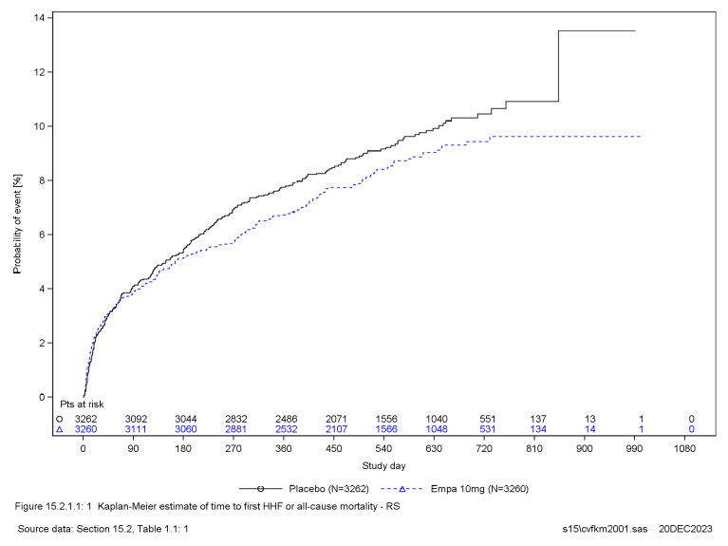
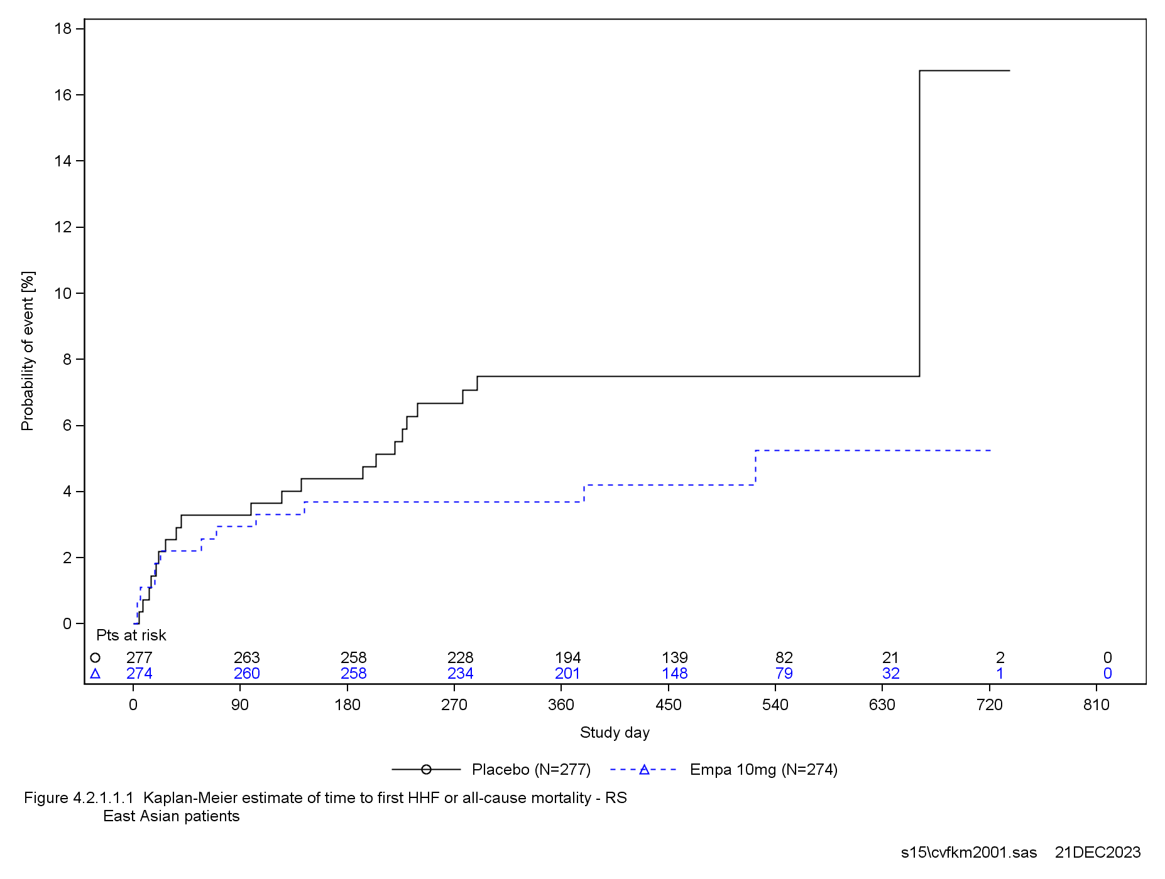
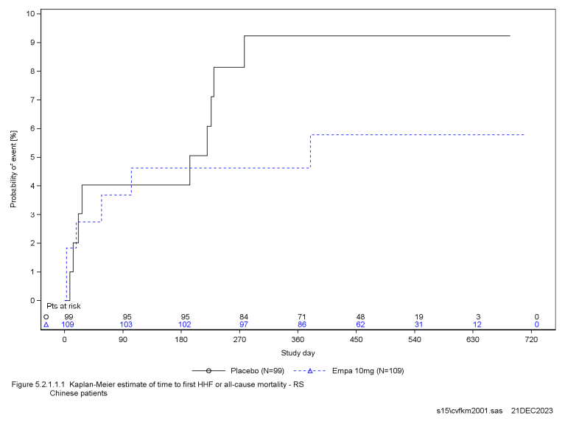
Primary endpoint - Time to first HHF or all−cause mortality
Global
EA
CN
 | Global |  | EA |  | CN
 | Placebo N (%) | Empa 10mg N (%) | Placebo N (%) | Empa 10mg N (%) | Placebo N (%) | Empa 10mg N (%)
# of analy. pts | 3262 (100.0) | 3260 (100.0) | 277 (100.0) | 274 (100.0) | 99 (100.0) | 109 (100.0)
# of pts with event; N(%) | 298 (9.1) | 267 (8.2) | 21 (7.6) | 12 (4.4) | 9 (9.1) | 6 (5.5)
Incidence rate ( pts with event per 100 pt years at risk ) | 6.58 | 5.85 | 6.46 | 3.63 | 7.86 | 4.49
EMPA vs Plb HR* (95% CI) |  | 0.90 (0.76,1.06) |  | 0.52 (0.25,1.08) |  | 0.42 (0.14,1.29)
P-value |  | 0.2061 |  | - |  | -
* Hazard ratio (EMPA vs. Plb) based on a Cox regression model with terms for age [years], T2D at baseline, region, baseline eGFR (CKD−EPI) [ml/min/1.73m²] (4 cat.), baseline LVEF [%] (2 cat.), persistent or permanent atrial fibrillation at baseline, history of MI, peripheral artery disease at baseline, smoking at baseline and treatment.
No difference in risk of HHF or all−cause mortality

Slide 41
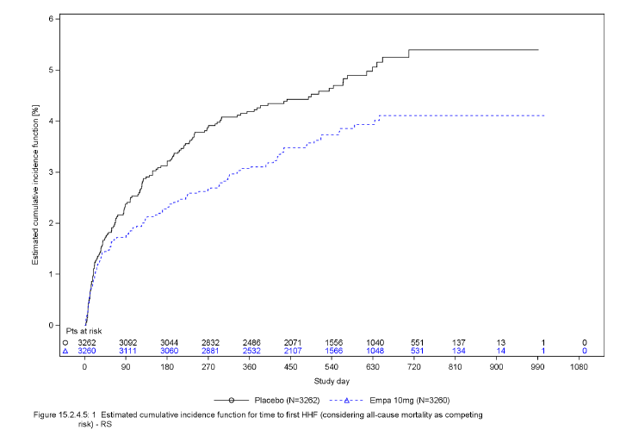
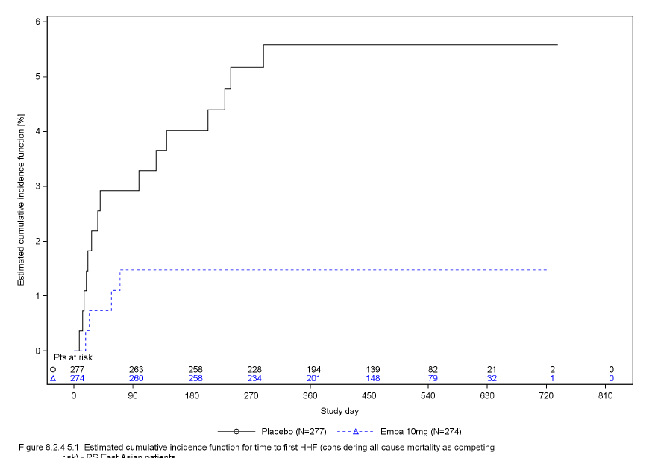
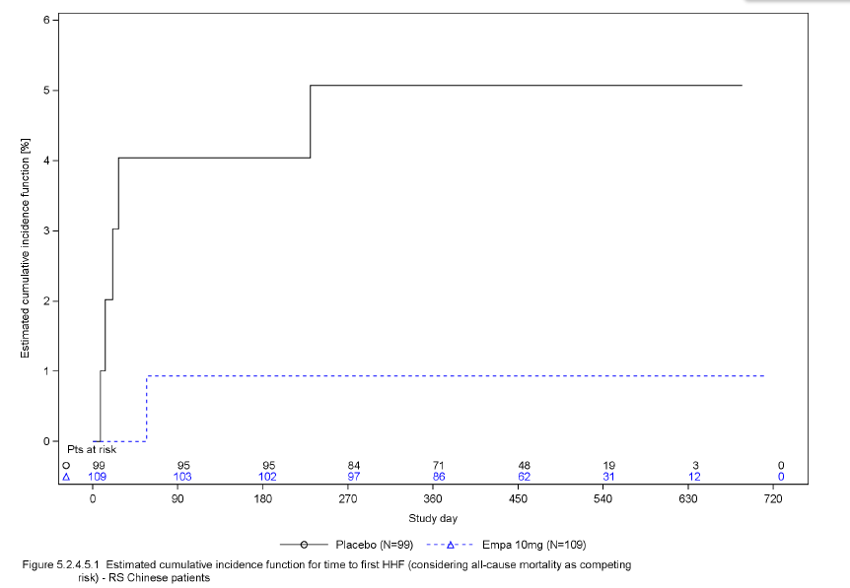
Component of the primary endpoint - Time to first HHF
Global
East Asia
CN
 | Global |  | EA |  | CN
 | Placebo N (%) | Empa 10mg N (%) | Placebo N (%) | Empa 10mg N (%) | Placebo N (%) | Empa 10mg N (%)
# of analy. pts | 3262 | 3260 | 277 | 274 | 99 | 109
# of pts with event; N(%) | 153 (4.7) | 118 (3.6) | 15 (5.4) | 4 (1.5) | 5 (5.1) | 1 (0.9)
Incidence rate ( pts with event per 100 pt years at risk ) | 3.38 | 2.58 | 4.62 | 1.21 | 4.37 | 0.75
EMPA vs Plb HR* (95% CI) |  | 0.77 (0.60,0.98) |  | 0.26 (0.09,0.81) | PH model is not produced, total number of events < 7 x number of treatment groups
P-value |  | 0.0311 |  | -
Numerical reduction in the risk of HHF
Not confirmed in the confirmatory testing

Slide 42
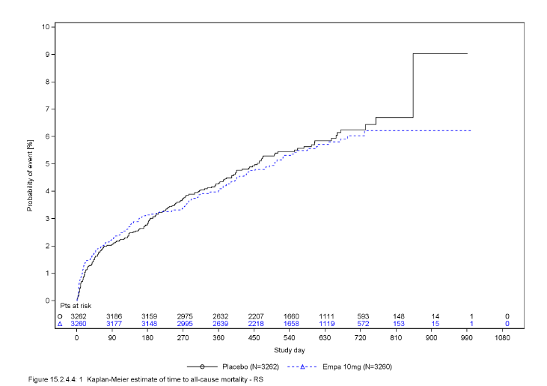
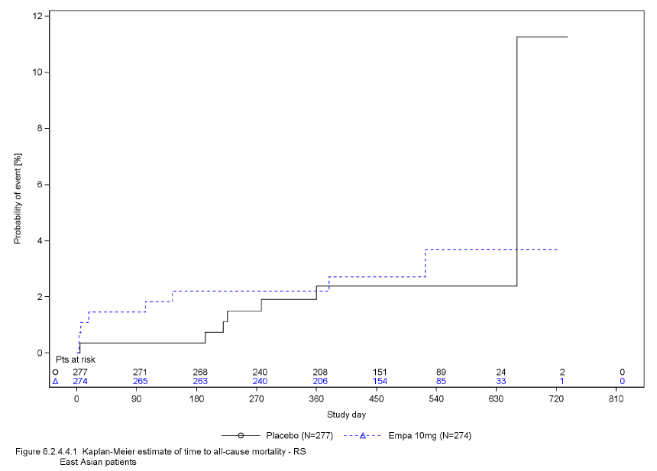
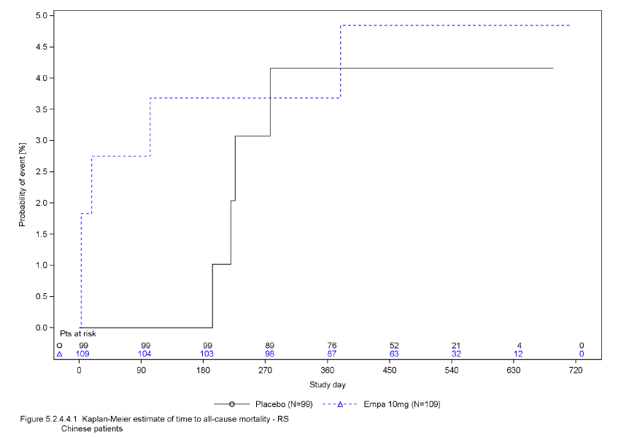
Component of the primary endpoint – Time to all-cause mortality
Global
East Asia
CN
 | Global |  | EA |  | CN
 | Placebo N (%) | Empa 10mg N (%) | Placebo N (%) | Empa 10mg N (%) | Placebo N (%) | Empa 10mg N (%)
# of analy. pts | 3262 | 3260 | 277 | 274 | 99 | 109
# of pts with event; N(%) | 178 (5.5) | 169 (5.2) | 7 (2.5) | 8 (2.9) | 4 (4.0) | 5 (4.6)
Incidence rate ( pts with event per 100 pt years at risk ) | 3.75 | 3.56 | 2.05 | 2.36 | 3.31 | 3.70
EMPA vs Plb HR* (95% CI) |  | 0.96 (0.78,1.19) |  | 1.00 (0.35,2.89) | PH model is not produced, total number of events < 7 x number of treatment groups
P-value |  | 0.7319 |  | -
No difference in risk of all-cause mortality
* PH model is not produced, total number of events < 7 x number of treatment groups

Slide 43
EMPACT-MI NDA submission analysis
Scenario | Benefit | Risk
Scenario 1 No indication submission No label update | Still could leverage HF outcome to enhance safety and efficacy of EMPA Same as FDA & EMA | Potential challenge from customer and need resource to response
Scenario 2 Indication submission | Expand population to preclinical HF after AMI Strengthen the awareness of HF prevention and create complete evidence chain across HF process Enlarge brand influence and increase customer stickiness through continuously and interdisciplinary new indication | Extremely low possibility of full approval from CDE and conditional approval may be the best result PAC may have to be RCT due to neutral global results and small population in China Need to build database if RWS allowed since no existing database currently Need global approval
Scenario 3 Label update only | Support complete evidence chain across HF process and enlarge brand influence based on better data among EastAsia and Chinese population | Challenge from CDE that no significant benefit in both global and China subgroup Need global approval due to reactive communication strategy

Slide 44
NOT submit indication and label update request to CDE.
TARM endorsed team’s decision on not pursuing further health authority interaction for indication/label update application.
Background:
EMPACT-MI result has been published in ACC 2024 on 5th Apr: Point estimate for primary endpoint was 0.90, with 95%CI 0.76-1.06. While exploratory, EMPA demonstrated 23% RRR for first HHF (HR 0.77; 95% CI: 0.60, 0.98), and 33% RRR for total HHF (RR 0.67; 95% CI: 0.51, 0.89).
FDA rejected submission of post-MI indication, and there will be no submission to FDA or EMA. Japan is communicating with HA about submission.
Team's decision (Endorsed by TARM):
NOT submit indication to CDE given the below analysis
  Primary endpoint not met, while EMPA demonstrated significant benefit just as exploratory endpoint. Although COVID-19 would have some negative impact in HHF, it is hard to provide strong evidence to support the explanation.
  FDA reject submission of post-MI indication, and global has decided no submission to FDA or EMA.
  Potential risk that CDE may reject to approve the indication or require to provide PAC result in form of RCT or RWS.
  There is no existing database of AMI that PAC would be difficult to be conducted.
  Updated international and local guideline has already extended SGLT2i to HF prevention in specific patient. From clinical practice perspective, the guideline recommendation has covered a certain part of Post-MI population.
NOT submit label update request to CDE: Clinical section part update is based on entire population instead of subgroup level data alone.
Next step:
Communicate with both global and local evidence team to decide whether to publish Chinese subgroup analysis.

Slide 45
Ongoing:
Empagliflozin (SGLT2 inhibitor): Post Myocardial Infarction (Post MI)
2020 |  |  |  | 2021 |  |  |  | 2022 |  |  |  | 2023 |  |  |  | 2024 |  | 2025
Q1 | Q2 | Q3 | Q4 | Q1 | Q2 | Q3 | Q4 | Q1 | Q2 | Q3 | Q4 | Q1 | Q2 | Q3 | Q4 | Q1 Q2 | Q3 Q4 | Q1 Q2 | Q3 Q4
Global
10 Dec 2020
28 Feb 2023
Aug2024 (PR)
Dec2024 (Base)
27Oct2023
Feb2024
Empa post MI Ph3-1245.202
N=~6500
NDA review
FSS
LSS
LSC
NDA
Sub
NDA App
Global Status:
LSC shifted to Oct2023, submission timelines shifted accordingly.
Breakthrough Therapy Designation will be applied in US if topline result is positive
FDA interaction planned in Mar-Apr, timelines would be much clearer after the interaction
04Dec/DBL
22Dec/TLR
Option 1:
pre-NDA+PR
NDA App: Feb2025 (best)
China
NDA sub:
Apr 2024
NDA review
Empa post MI Ph3-1245.202 (FSO to LabCorp)
Pre-NDA sub/feedback: 05Jan/Mar 2024
15 Sep
2020
26 Nov
2020
5 Feb 2021
15 Sep
2021
2 Oct
2021
28 Feb 2023
27Oct2023
N= 208/220
NDA review
CTA
kickoff
CTA
Sub
CTA
Appr
1st SIV
FSS
LSS
LSC
NDA Sub:
Mar2024
NDA App:
Jun2025 (base)
Option 2:
No pre-NDA+ no PR
China Status:
Waiting for further update from global after the FDA consultation
NDA kick-off meeting on Apr 12th, team aligned to go for Priority Review (PR) if TLR is positive, will revisit the strategy after TLR available (Oct 2023).
High registration risk due to small Chinese patient sample size (3.2%).
45

Slide 46
EMPA CKD pediatric study
Purpose: Seek Empa pediatric CKD indication approval ONLY in US and EU to get 6-month patent extension
China’s participation in this study: Only to contribute patients and global doesn’t have any plan to get the indication approved in China
Feasibility is low:
  The prevalence of CKD in adolescent and children in China is around 0.7%
  External competitor’s trial FIONA for pediatric CKD: China sites were suspended, assuming no CN patients enrolled
  BI internal experience in pediatric T2DM: very hard to enroll any pediatric patient
CN team’s decision: China will not join the Empa CKD pediatric study, which has been aligned with marketing colleagues

Slide 47
Avenciguat (sGC activator)

Slide 48
Ongoing:
Avenciguat (sGC activator): Clinically Significant Portal Hypertension with Compensated/Decompensated Cirrhosis (CSPH in CC/DC)
2022 |  |  |  | 2023 |  |  |  | 2024 |  |  |  | 2025 |  |  |  | 2026 |  |  |  | 2027
Q1 | Q2 | Q3 | Q4 | Q1 | Q2 | Q3 | Q4 | Q1 | Q2 | Q3 | Q4 | Q1 | Q2 | Q3 | Q4 | Q1 | Q2 | Q3 | Q4 | Q1 | Q2 | Q3 | Q4
Global
We are here
IA results of .21 (CC-ARLD) to be released
  Development decision to be made in May HPSC
  BTD application pending
  Timeline of following milestones may be adjusted
HPSC endorsed re-assessment of development in CKD with focus on glomerular diseases
  PoCC met in both Ph II CKD trials
  Targeting niSOD in Jun HPSC
LSR achieved in .21 and .29 (CC-ARLD, CC-MASH) in end Mar
Enrollment of .55 (eDC) extended from Mar to May
27 Apr 2022
16Feb2024/LSS
24Oct2024
Ph2-1366.21
CC due to alcoholic liver disease, N=78
14Nov2024
FSS
19Mar
Interim analysis
LSC
DBL
1366.27 (gPh III)
Ph2-1366.29
14 Jan 2022
28 Jun 2022
11Jun2024
NDA sub/app (CC)
Jan/Oct 2030
CC due to NASH, HBV, HCV, N=80
Jul2024
CTA Sub
FSS
15Feb2024/LSS
LSC
DBL
May2024
Ph2-1366.55
N=40
1 Aug
Jan2024
Aug2024
1366.30 (gPh III)
30Jun
eDC, N=40
Sep2024
NDA sub/app (eDC)
Jan/Oct 2029
Final
protocol
CTA Sub
1st SIV
LSS
LSC
DBL
China
22Mar
9 May
16Feb2024
24Oct2024
Ph2-1366.21
N = 7/6 (China ML)
N =1/2 (TW)
1366.27 (gPh III)
1st SIV
FSS
18Nov
LSS
LSC
NDA sub/app (CC)
Feb 2030/May 2031
Ph2-1366.29
3 Mar 2022
24 Oct
2022
28Nov2023
11Jun2024
CTA Review + EC + HGRAC + 1st SIV (7 M)
n= 9 /5
CTA Sub*
1st SIV
FSS
LSS
LSC
11Aug
31Oct
Aug2024
1366.30 (gPh III)
May2024
Ph2-1366.55
n=2/40
3Jan2024
.55 (eDC) Global First Subject Randomization achieved in Nanfang Hospital
NDA sub/app (eDC)
Feb 2029/Aug 2030
CTA Review + EC + HGRAC + 1st SIV (5M)
n=2
Sep2024
1st SIV
LSS
DBL
CTA Sub
CTA appr
LSC
Confidential
ARLD: alcohol-related liver disease
CC: compensated cirrhosis
eDC: early decompensated cirrhosis
siSOD: new indication start of development

Slide 49
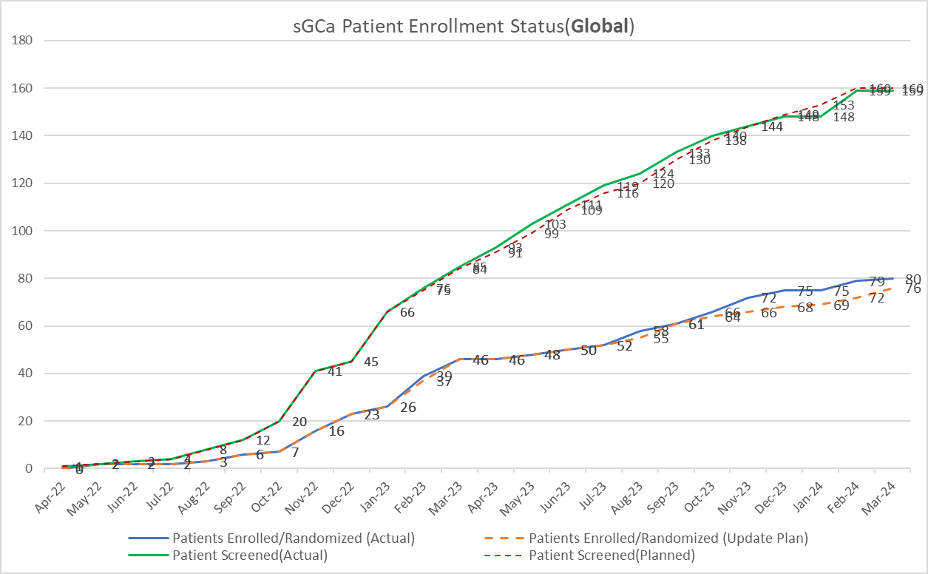
1366.21 sGCa-CSPH/CC-ARLD enrollment -Global (cut off date: 15Apr2024)
Global staus: 159 pts screened, 80 pts randomized, 79 screened failure (SF 51%)

Slide 50
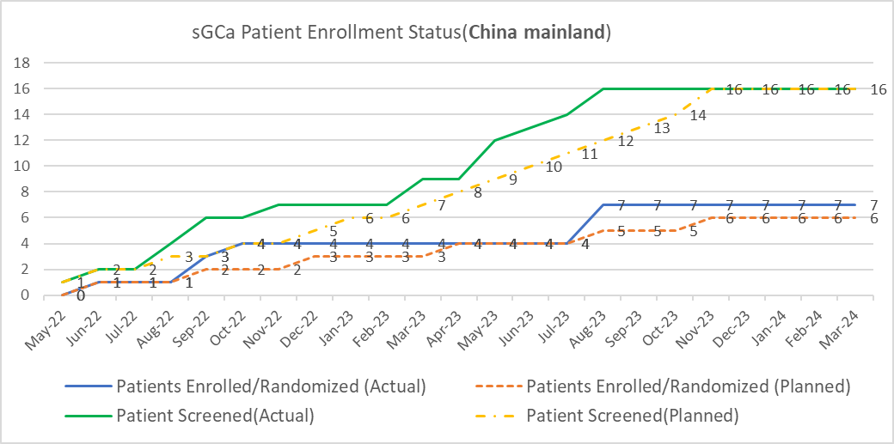
1366.21 sGCa-CSPH/CC-ARLD enrollment –China Mainland (cut off date: 15Apr2024)
China staus: 16 pts screened, 7 pts randomized, 9 pts screen failure (SF 56%)

Slide 51
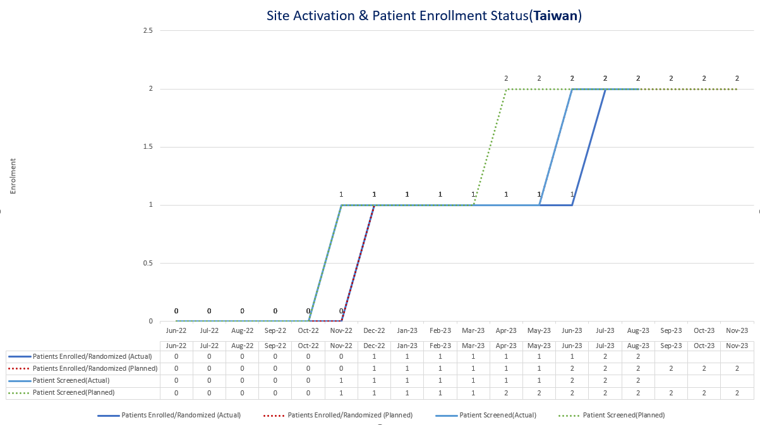
1366.21 sGCa-CSPH/CC-ARLD enrollment –Taiwan (cut off date: 15Apr2024)

Slide 52
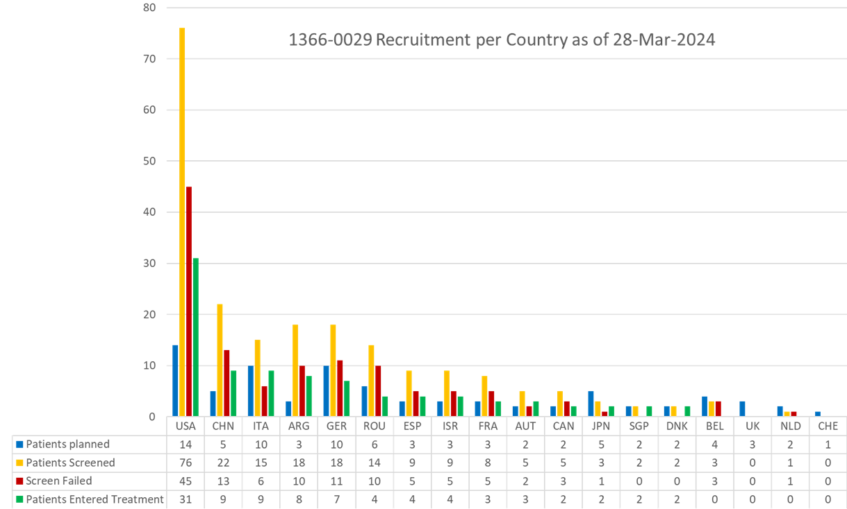
1366.29 sGCa-CSPH/CC-MASH enrollment completion- Global (cut off date: 28Mar2024)
90randomized
210 screened
SF rate 57.1%

Slide 53
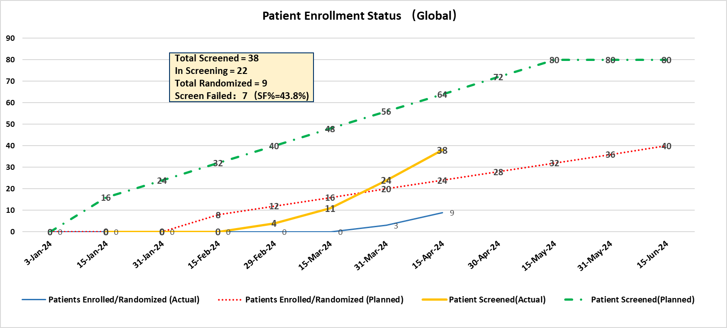
1366.55 sGCa-CSPH/eDC enrollment –Global (cut off date: 10Apr2024)

Slide 54
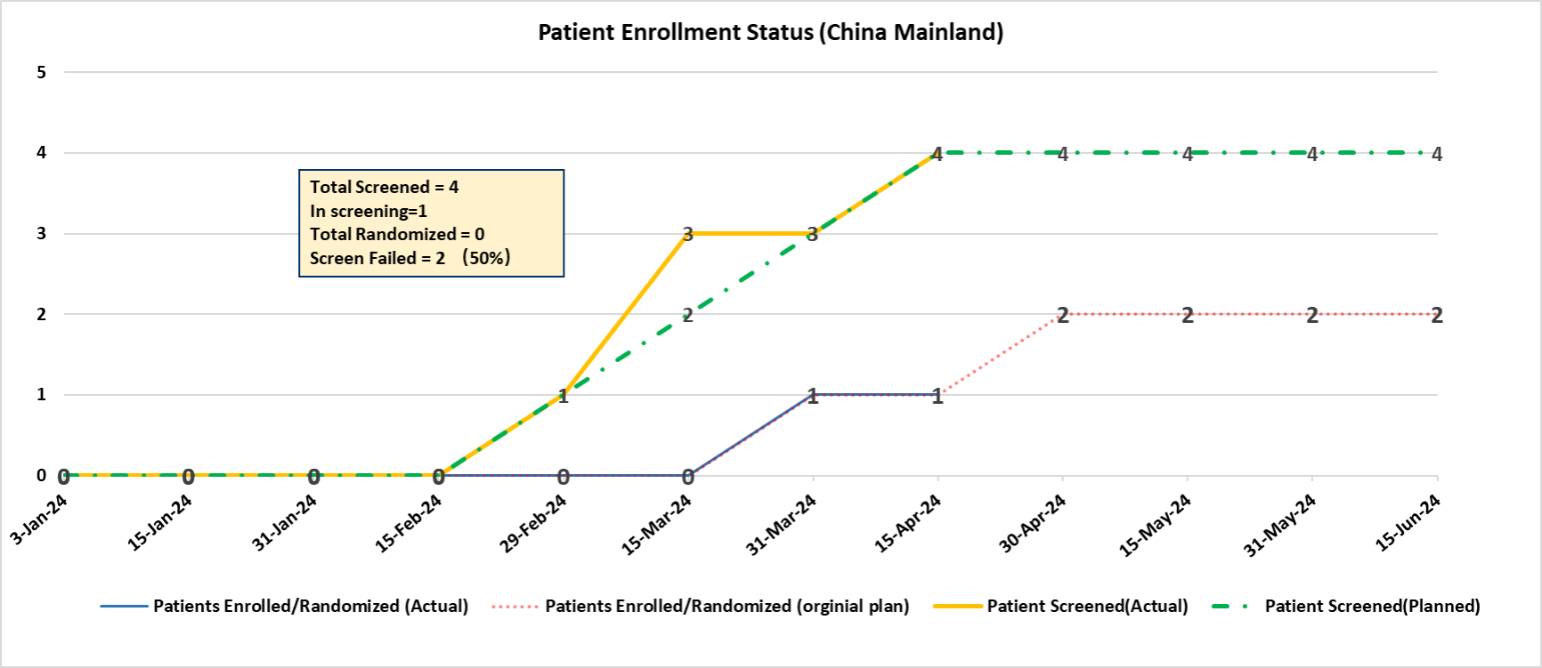
1366.55 sGCa-CSPH/eDC enrollment -China (cut off date: 10Apr2024)

Slide 55
BI 764198 (TRPC6 inhibitor)

Slide 56
Ongoing:
BI 764198 (TRPC6 inhibitor): FSGS (Focal Segmental Glomerulosclerosis)
2022 |  | 2023 |  | 2024 |  |  |  | 2025 |  |  |  | 2026 |  |  |  | 2027
Q1 Q2 | Q3 Q4 | Q1 Q2 | Q3 Q4 | Q1 | Q2 | Q3 | Q4 | Q1 | Q2 | Q3 | Q4 | Q1 | Q2 | Q3 | Q4 | Q1 | Q2 | Q3 | Q4
Global
15 Jun 2022
We are here
Sep 2024
Feb 2025
N=60
Mar 2025
Ph2a-1434.0004
Sep 2025
Recruitment on track to achieve LSS in Sep 2024
Interim analysis performed in Mar
  Results remain confidential
  Advisory Board meeting to be held in May
FSS
LSS
LSC
DBL
CTR
Ph2/3-1434.XX
NDA App: Jul
2030
China participation decision in Mar
China
Sep
2022
Jun
2022
27Feb2023
Sep 2024
Feb 2025
Mar 2025
Ph2a-1434.0004
CTA review + EC +HGRAC
+ 1st SIV (8.5 M)
N= 5/3 (China)
China randomized the 5th patient
CTA
appr
Sep 2025
CTA
sub
1st SIV
LSC
LSS
DBL
CTR
Ph2/3-1434.XX
NDA App:
Mar 2030

Slide 57
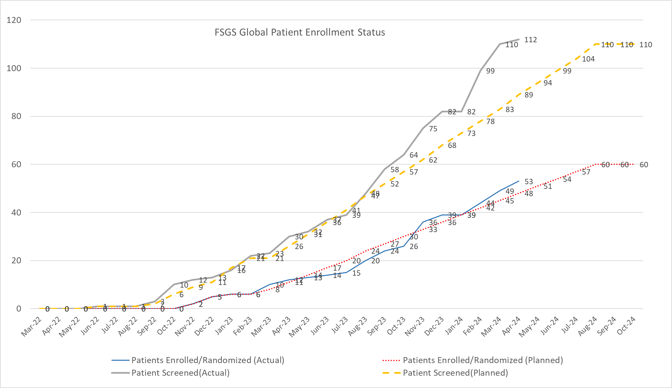
BI 764198 (TRPC6 inhibitor) FSGS enrollment – Global (Cut-off date: 15Apr2024)
Global status: 112 pts screened, 53 pts randomized, 56 screened failure (SF 50%), currently 4 pts in screening

Slide 58
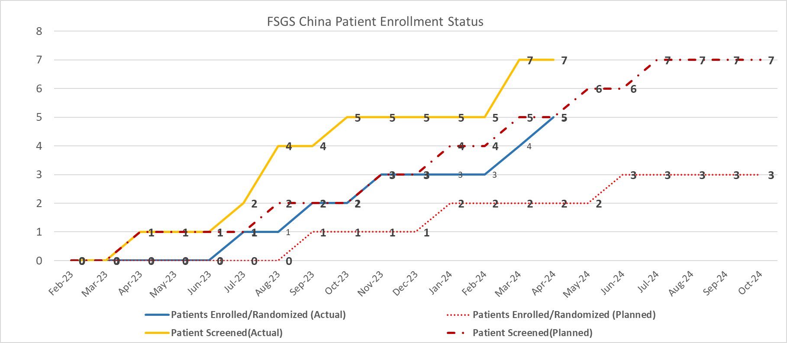
BI 764198 (TRPC6 inhibitor) FSGS Enrollment – China (Cut off date: 15Apr2024)
China status: 7 pts screened, 5 pts randomized, 2 patient screen failure (SF 29%), currently 0 pt in screening

Slide 59
BI 1820237
(NPY2+Survodutide FDC)

Slide 60
Ongoing:
BI 1820237 (NPY2+survodutide FDC): Obesity
2024 |  |  |  | 2025 |  |  |  | 2026 |  |  |  | 2027 |  |  |  | 2028 |  |  |  | 2029 |  |  |  | 2030
Q1 | Q2 | Q3 | Q4 | Q1 | Q2 | Q3 | Q4 | Q1 | Q2 | Q3 | Q4 | Q1 | Q2 | Q3 | Q4 | Q1 | Q2 | Q3 | Q4 | Q1 | Q2 | Q3 | Q4 | Q1 | Q2 | Q3 | Q4
Global
We are here
May2025
May2026
June
2026
28 Jul 2024
Nov 2024
Ph2 (N = 400)
Dec 2026
Dec 2028
Ph2-
1458.4
Final Protocol
FSS
LSS
LSC
Key result
Ph3 pivotal
FSS
Key results
PoCC June 2024
Dec 2026
Dec 2028
Ph3 pivotal
NDA sub
Aug 2029
NDA sub
Aug 2030
FSS
Key results
May 2029
Ph3
Dec 2026
II
global Ph II preparation on hold until Oct 2024 when the full final Ph I MRD results (including NPY2R + survo combination) are available and shared with HPSC
Ph3 cardio safety
FSS
Key results
Global
Global Ph II (.4) preparation on hold
  Value proposition for NPY2R FDC commercially challenging
  NPY2R + survo combination data pending → Sep 2024
PoCC:
  IA results of Ph I NPY2R + semaglutide (GLP-1 agonist) combo to be available on 13 May to support PoCC
  gAT to present the IA data and a lean economic evaluation in Jun HPSC
China
Global Ph II (.4) pre-IND submitted on 30 Mar
China Ph I MRD (.7) also on hold
China
Jul/Aug 2024
May2026
June
2026
Mar2024
Feb 2025
CTA+ EC + HGRAC + SIV (6M)
May2025
Ph2-
1458.4
Pre-IND
Ph2
LSS
LSC
Key result
pre-IND Sub
CTA Sub
SIV
China MRD PK/PD
w/ Pbo arm
1458.7
June2024
Sep2024
Mar 2025
June 2025
Jan
2026
Pre-IND (3M)
CTA+ EC + HGRAC + 1st SIV (6M)
N=30
Treatment
(~25 w
TBC)
Mar2026
pre-IND Sub
CTA Sub
SIV
LSS
LSC
Key result
Ph3
Mar 2027
Oct 2028
Ph3 pivotal
pre-IND Sub
CTA Sub
SIV
LSC
NDA sub
Sep 2029
NDA sub
Mar 2031
Jun 2026
Sep 2026
Mar 2029
Ph3 cardio safety
SIV
LSC

Slide 61
China PMO Study Overview - CRM
Product | Indication | Study type/Global Status (Study no.: FPI-LPO, CTR) | China Dev. Strat. | Current Status | Next Milestone | Key Updates
Jardiance (Empagliflozin) | HFrEF | China local NISed (1245.0291:Nov 2021-Q1 2026) | China alone | IEC approval | Final results | NIS qualification collection collection(2nd round) and SEAP review
Jardiance (Empagliflozin) | HFpEF | China local NISed (1245.0313:Q4 2022-Q1 2026) | China alone | IEC approval | Final results | NIS qualification collection collection(2nd round) and SEAP review
Survodutide | Obesity BMI cutoff definitions among China and Japan | China local NISed | China alone | Global approval | Protocol approval | Protocol preparation, database questionnaire review and communication, essential documents collection ~ 2 months delay of protocol approval due to the implementation of new ONIS process, leading to changes in the authors and content of protocol
Survodutide | Obesity+MASLD | China local NISed | China alone | Global approval | Protocol approval | Protocol preparation, database questionnaire review and communication
Notes:
2 months of delay due to the implementation of new ONIS process, leading to changes in the authors and content of protocol

Slide 62
Back-up

Slide 63
CRM development pipeline 2023 achievements
Empagliflozin add on insulin (T2DM)
Empagliflozin (CKD)
2
NDA appr
5
CTA appr
4
trial completion
6
Regional input
4
readout
8
HAI sub
6
CTA sub
Survodutide (obesity, 1404.0038, 41, 40)
Survodutide (obesity, 1404.0061)
Survodutide (CN PK, 1404.0013)
BI 685509 (sGCa, CSPH early decompensated, 1366.0055)
Survodutide (obesity, 1404.0038, 41, 40, 61)
BI 685509 (sGCa, CSPH early decompensated, 1366.0055)
BI 685509 (sGCa 1366.0005 )/DKD Ph2
BI 685509 (sGCa 1366.0022 )/non-diabetic CKD Ph2
BI 690517 (ASi 1378.0005 )/CKD Ph2
Empa/post MI (1245.0202) Ph3
Pre-NDA/variation
Empagliflozin (pediatric T2DM)
Pre-IND
Survodutide (obesity, 1404.0038, 41, 40, 61)
BI 690517 (Asi+Empa, CKD, 1378.0006)
Type III HAI
BI 1810237 (NPY2R +survodutide, obesity, Ph2 early integration)
BI 3006337 (GLP-1/FGF-21, NASH, Ph2 early integration)
BI 685509 (sGCa, CSPH, Ph3 development plan)
ASi in CKD and CHF RoFD
MYDGF in STEMI PoCP
sGCa in CSPH PoCC
Survodutide in NASH RoFD
Survodutide in CVOT and CVRR
Survodutide packaging
Empagliflozin / Post-MI Ph3
ASi + Empagliflozin/CKD Ph2
sGCa / non-diabetic CKD & DKD Ph2

Slide 64
2024 CRM Outlook
8
8
Pre-IND submission/feedback
Trial initiation
Survodutide (NASH F2/3, F4, Ph3)
Survodutide (HFpEF, Ph3)
Survodutide (CKD, Ph3)
Survodutide (CVRR, Ph3)
BI 690517 (Asi+Empa, CKD, Ph3)
BI 690517 (Asi+Empa, HFpEF, Ph3)
BI 1810237 (NPY2R +survodutide, obesity, Ph2)
BI 1810237 (NPY2R +survodutide, obesity, Ph1 CN PK)
Survodutide (Obesity .38, .41, .40, .61, Ph3)
Survodutide (CN PK, Ph1)
BI 690517 (ASi+Empa, CKD, Ph3)
BI 690517 (ASi+Empa, HFpEF, Ph3)
sGCa (CSPH early decompensated, .55, Ph2)
7
Recruitment completion
9
Survodutide (Obesity .38, .41, .61, Ph3)
Survodutide (CN PK, Ph1)
sGCa (CSPH, .21, .29, .55, Ph2)
CTA submission/approval
Survodutide (CN PK, Ph1)
Survodutide (NASH F2/3, Ph3)
Survodutide (NASH F4, Ph3)
Survodutide (CKD, Ph3)
Survodutide (HFpEF, Ph3)
BI 690517 (ASi+Empa, CKD, Ph3)
BI 690517 (ASi+Empa, HFpEF, Ph3)
BI 1810237 (NPY2R +survodutide, obesity, Ph2)
BI 1810237 (NPY2R +survodutide, obesity, Ph1 CN PK)
4
Readout
Survodutide (NASH, Ph2)
sGCa (CSPH, .21, .29, .55, Ph2)
1
NDA submission
Empagliflozin (Post- MI)

Slide 65
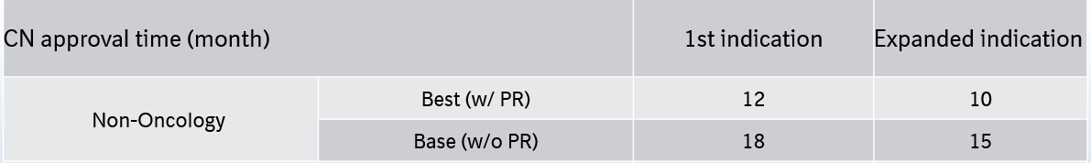
NDA/BLA timeline assumptions
Submission: China NDA/BLA submission within one month from global first NDA submission
Review:

